Slide 1
Office 365 development
Office add-ins best practices and guidelines Functional and UX design
Dean Slawson

Slide 2
Add-in best practices
https://msdn.microsoft.com/EN-US/library/office/mt590883.aspx
Functional & UX design
Design for deep value
First run
Sign-in
Add-in commands
UX quality
Performance
Marketing,
GTM
Store listing
Marketing
Website
Serving
Monitor
User voice & reviews
Update regularly
Post-launch
Learning
Selling
Notes:
Change order so first run stuff comes before add in commsnds on this slide and next and in the dec,k

Slide 3
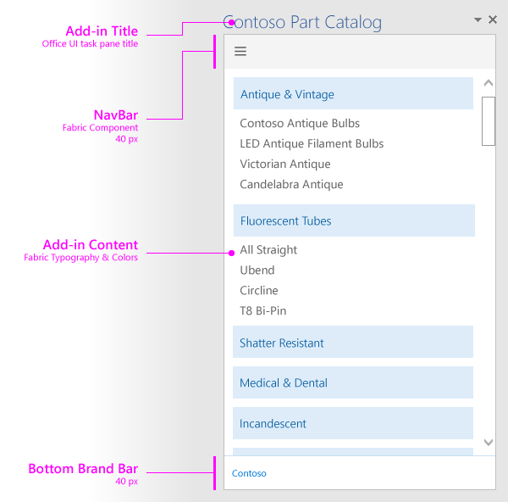
Add-in design guidelines and principles
Design explicitly for Office. The functionality and look and feel of an add-in should harmoniously complement the Office experience
Make users more productive. Help users do more or get one job done quickly. Enable seamless interaction between Office and your add-in
Favor content over chrome. Emphasize the add-in's content and functionality over any accessory chrome. Avoiding superfluous UI elements that don't add value to the user experience
Keep users in control. Allow users to understand any important decisions, control their experience, and easily reverse actions the add-in performs
Design for all Office platforms and input methods. Support both mouse/keyboard and touch input devices. Ensure UI is responsive to adapt to different form factors. Ensure accessibility needs are met
Design guidelines for Office add-ins: https://msdn.microsoft.com/en-us/library/office/mt484317.aspx

Slide 4
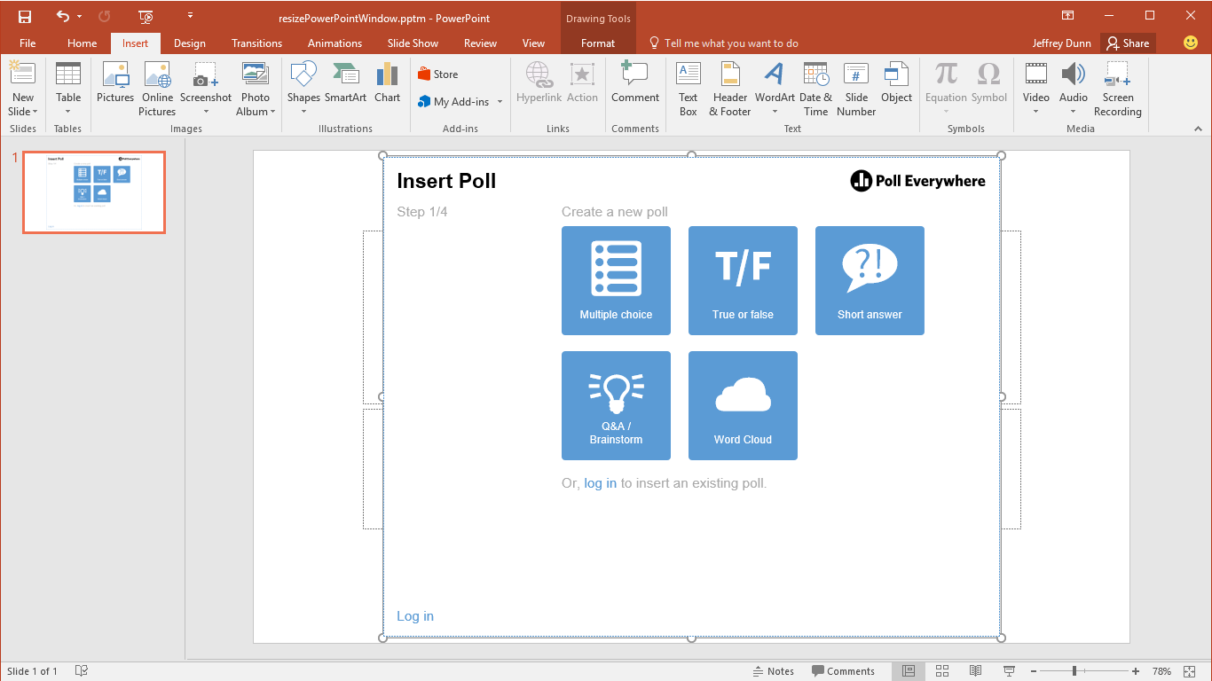
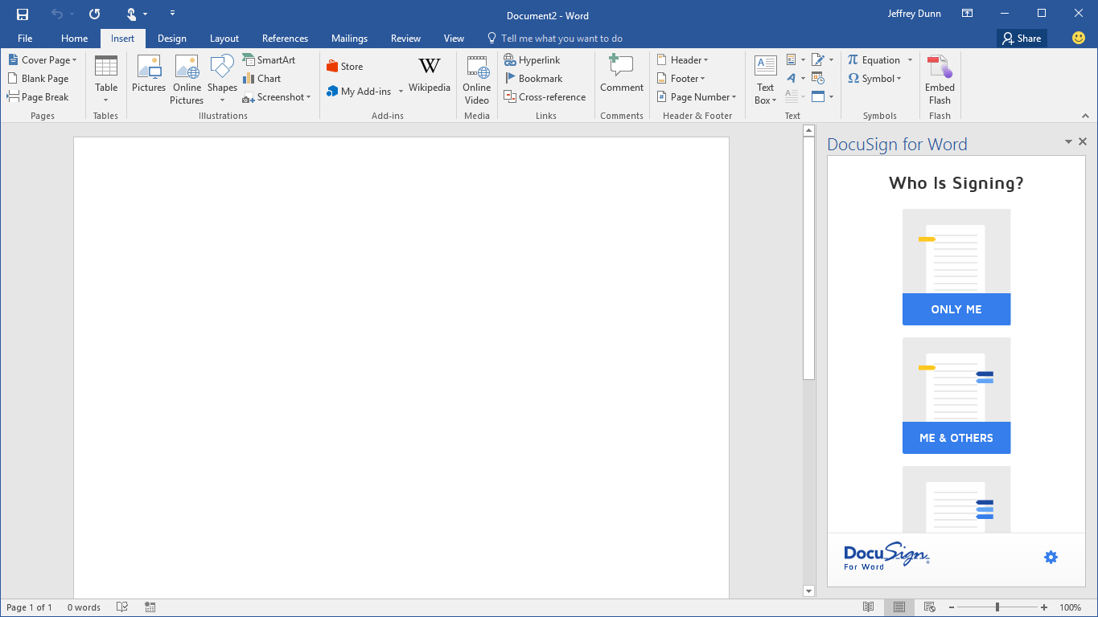
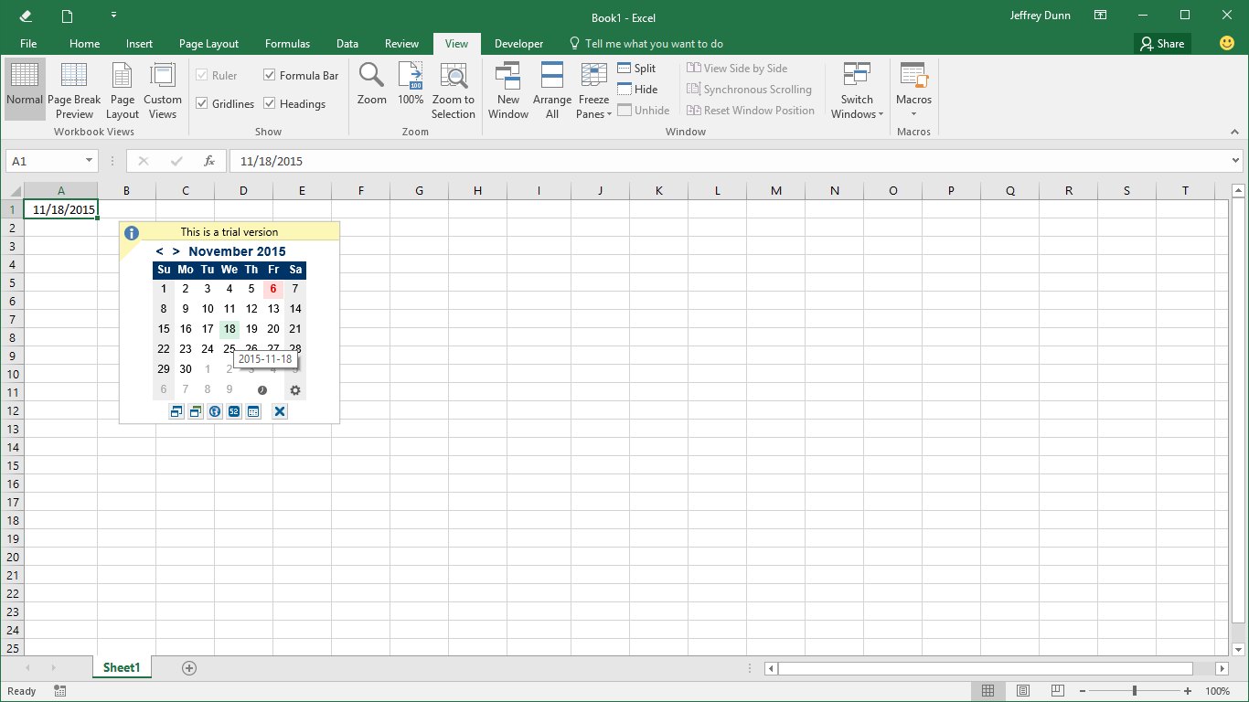
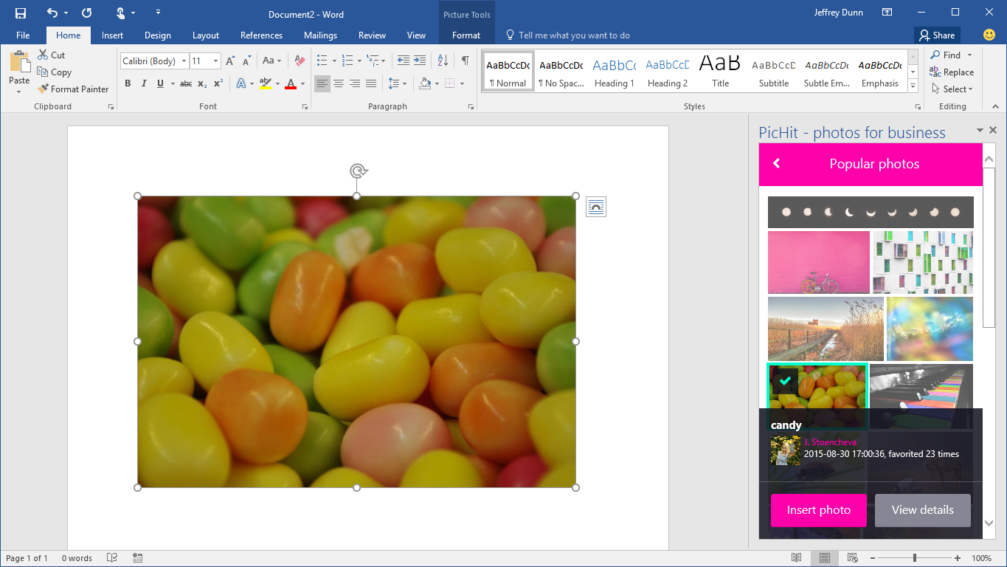
Offer deep value to your users
Add-ins must complement Office. Help users complete their tasks quickly and efficiently
Focus on scenarios and workflows that make sense in each of the Office applications
Provide strong reasons for users to engage with the add-in

Slide 5
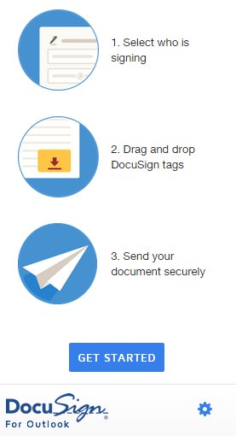
First run experiences that quickly engage users
Personalize and greet the user
Describe clearly the value your add-in offers before asking users to sign-in
Don’t assume users know how it works. Be prepared to show teaching UX and videos
Give free trials out of the box (no sign-ups). Freemium is good and mitigates user drop-offs. Show/tease the premium features
Keep new user sign-up dead simple. Prefill info you already have: email, display name. Skip email verifications

Slide 6
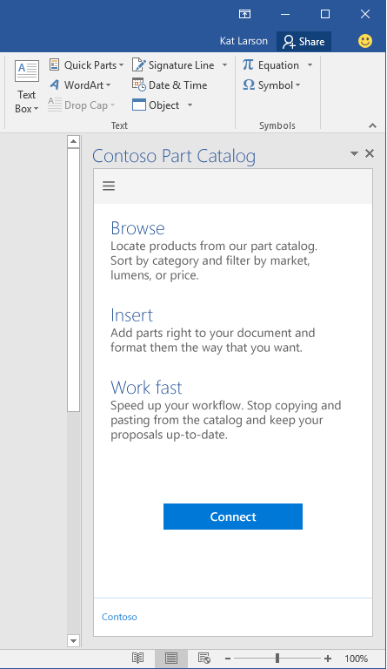
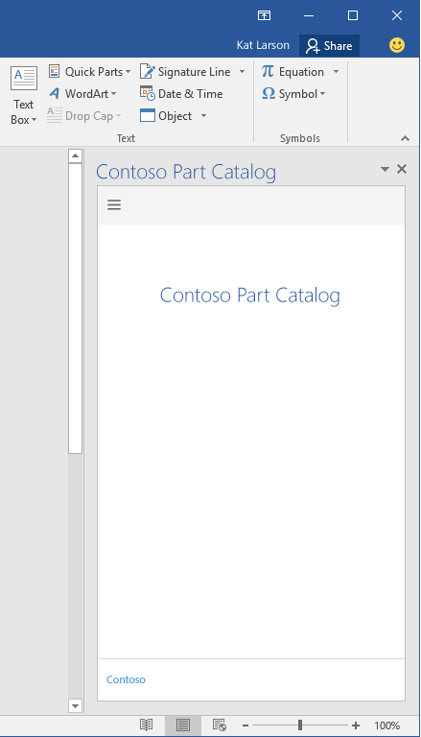

Engaging first run: placemats
DO
DON’T
Lead users into your experience
Assume users know how to begin
Notes:
Lead users into your experience
Help them understand the value of your add-in
If setup is required - give them a reason to invest more time and energy
Greet the user, be personal
Don’t assume they know how your add-in works

Slide 7
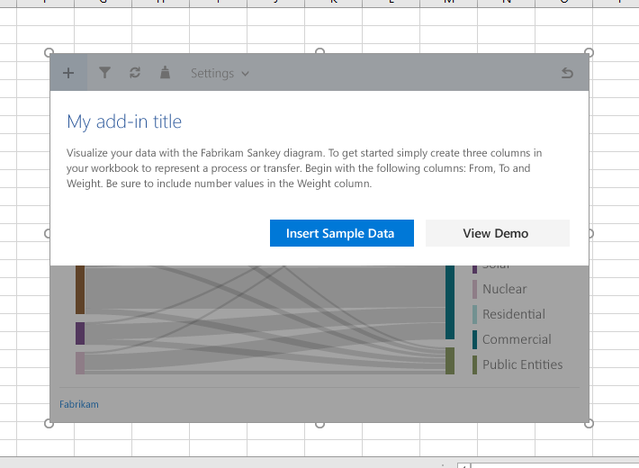
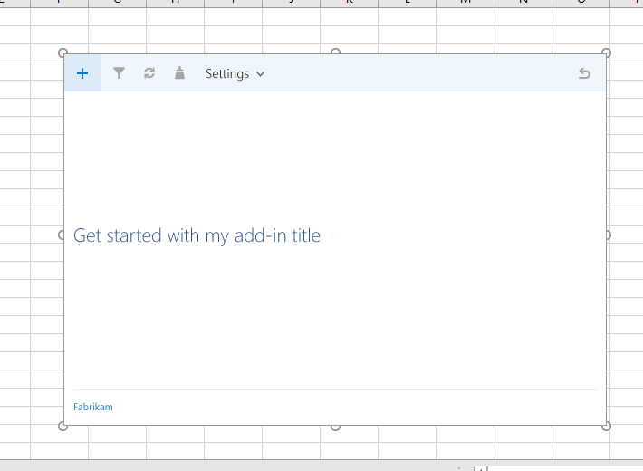
Include sample data
DO
DON’T
Include sample data
Assume users know how to engage with your add-in
Notes:
Lead users into your experience
Give hints of the end result with sample visualizations or pictures
Explain the steps they need to take to get to the end result
Provide ways to play with sample data
Include a “insert sample data” button
Use a primary button style
Focus the call-to action on getting started with samples

Slide 8
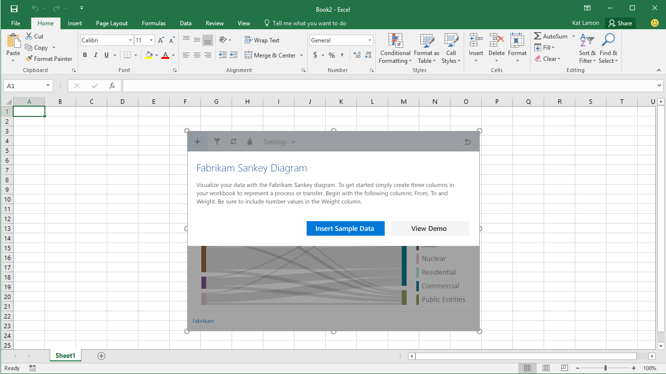
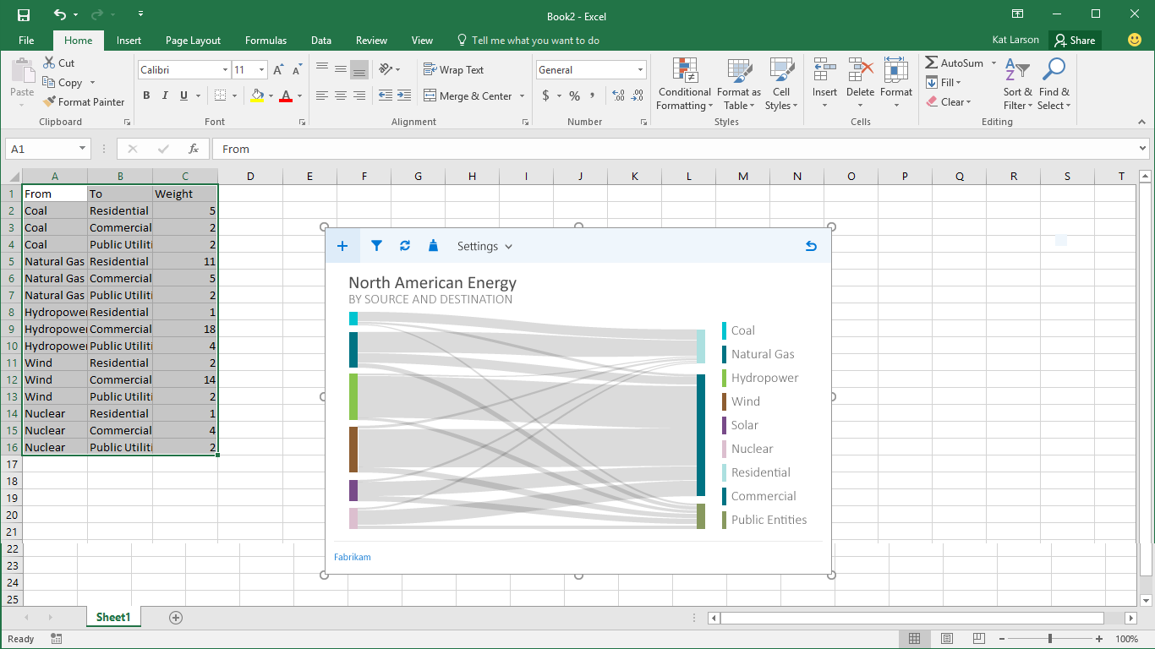

Slide 9
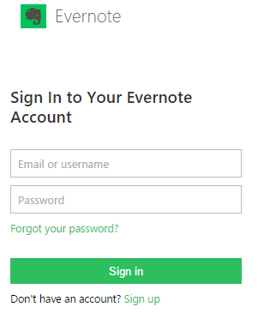
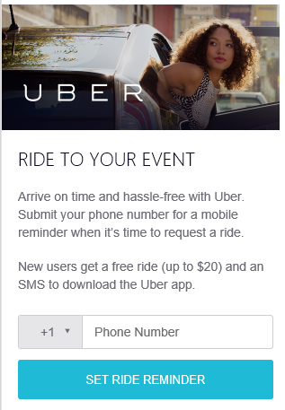
Single sign-on please (currently Outlook only)
Implement SSO to avoid drop-offs. Ensure SSO works in all Outlook clients
Exchange identity tokens will help provide SSO. Most of our best add-ins leverage this flow
Keep Auth. simple if you can. Yelp does not even require a sign-in. Uber uses the user’s phone number and verification to sign-in to the add-in
If your add-in requires Outlook REST API access, use OAuth v2 endpoint (see Boomerang add-in as an example and the getting started docs at dev.outlook.com.)

Slide 10
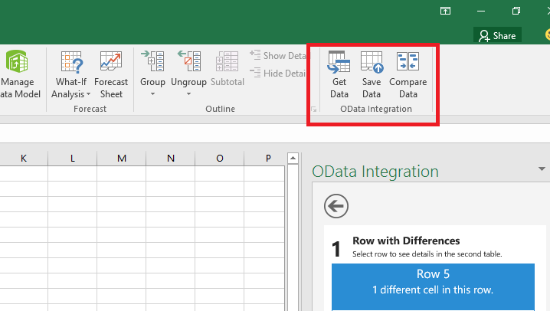
Add-in commands (currently Outlook only)
Plan to use add-in commands to place your add-in in user relevant flows
Use commands to represent a specific action with a clear and specific outcome for users. Do not combine multiple actions in a single button
Provide granular actions that make common tasks within your add-in more efficient to perform. Minimize the number of steps an action takes to complete
Provide meaningful icons and labels for buttons that clearly identify the action the user is taking
https://github.com/OfficeDev/Office-Add-in-Commands-Samples
https://msdn.microsoft.com/en-us/library/office/mt267546.aspx
Notes:
Custom UI hooks into Office applications
Entry points
Buttons on Ribbon
Contextual Menus
Actions
ShowTaskpane
ExecuteFunction

Slide 11
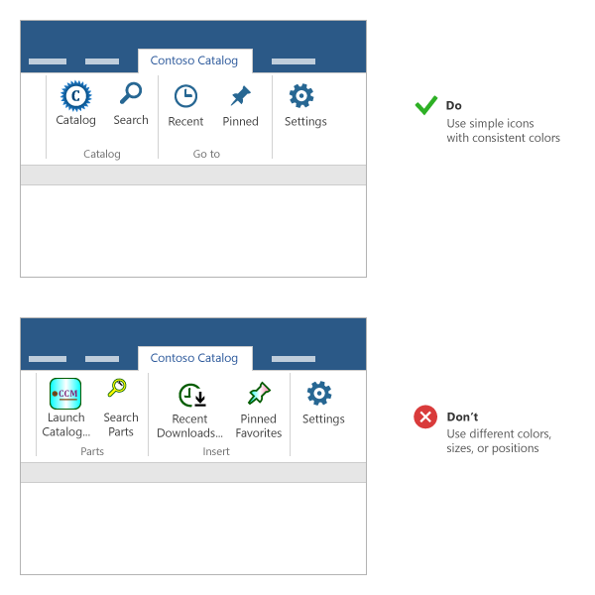
Icons in the ribbon
Keep your shapes simple and avoid multiple colors. Complex graphics are difficult to see at smaller sizes and resolutions
Don't reuse visual metaphors for dissimilar commands. The same icon used for different actions will cause confusion
Make your button labels clear and succinct. Use a combination of visual and textual information to convey meaning
Test your icons in light and dark Office themes and high contrast settings. Note that icons might be difficult to see on dark backgrounds or in high contrast mode
Use consistent icon sizes and positions to help with visual alignment on the ribbon
DO
Use simple icons with consistent colors
DON’T
Use different colors, sizes, or positions

Slide 12
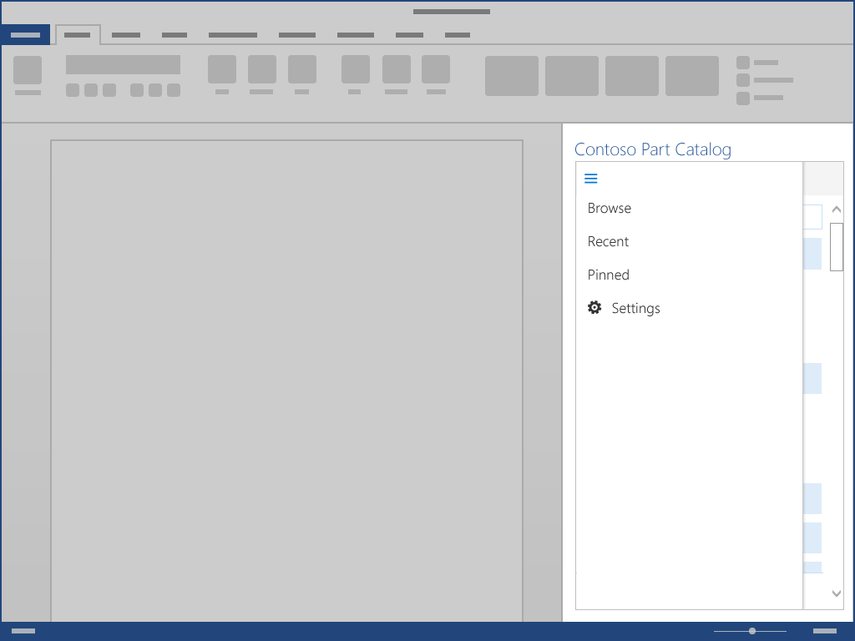
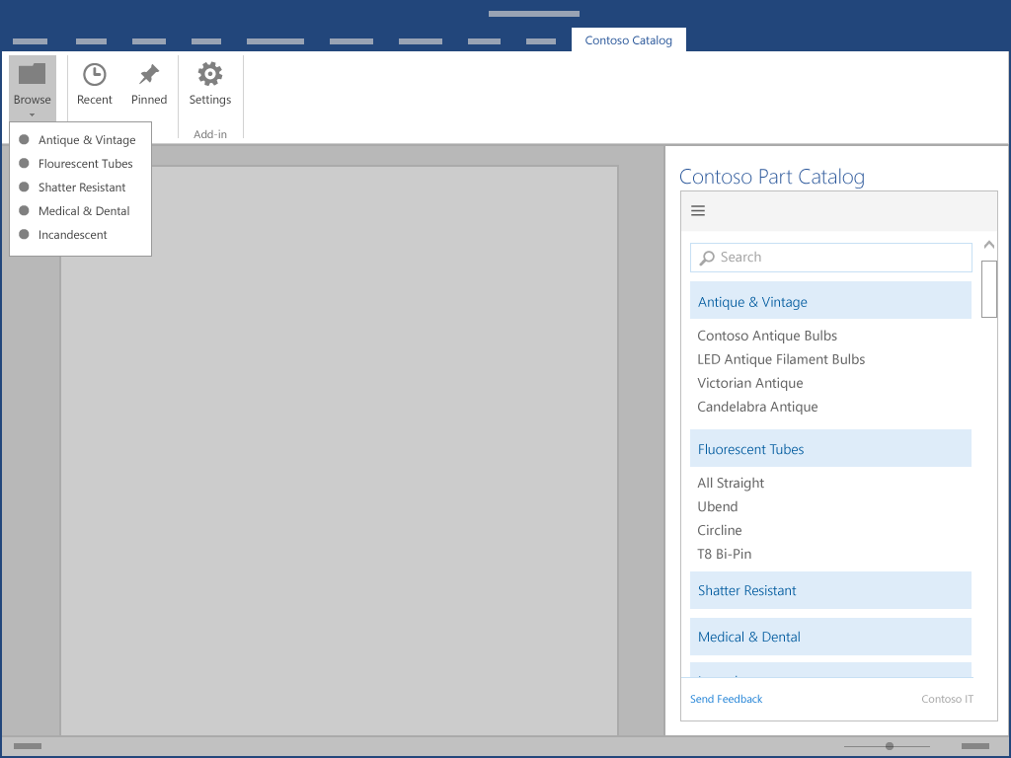
Factor your design to support multiple versions
Ribbon with grouped commands
Command—inserts to doc
Actions like search are in-line within task pane
Task pane contains all navigation and commanding
OFFICE 2013
OFFICE 2016
Task pane add-in
Modularize code so it can later be separated into commands
Use in-line buttons for local actions that directly tie to the content displayed on the taskpane to the action
Add-in with commands
Use commands. Groups for each main module. Ribbon buttons for each top-level action. Leverage Execute Action for actions that don’t require UI. Optimize for efficiency
Use Office UI Fabric for custom HTML UI
Use command functions consistent with what they are called in Office, where possible
Use in-line buttons for local actions

Slide 13
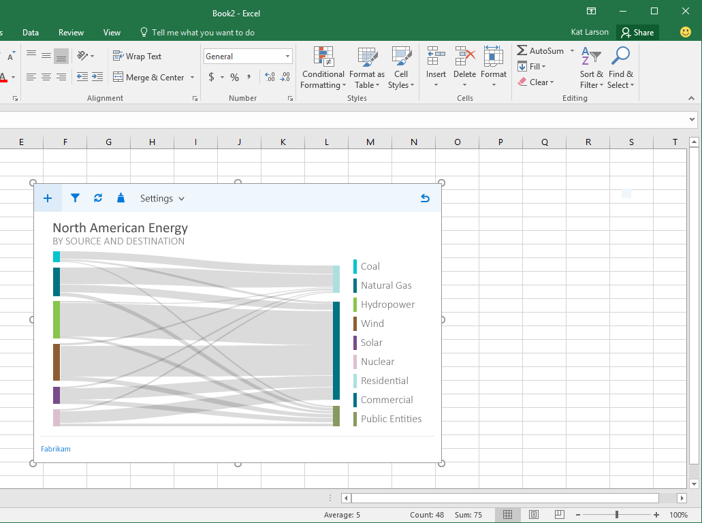
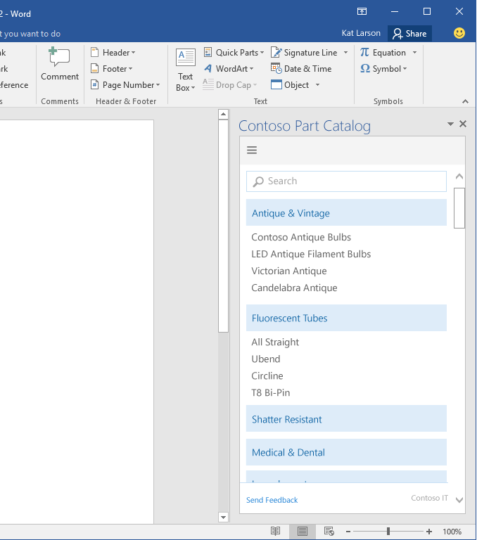
Use Office Fabric UI
http://dev.office.com/fabric
Nav Bar
component
Icons
Command Bar
component
Give UI space
Neutral colors default Office font
Notes:
Add call-outs as appropriate to this slide
Design for mobile first, touch experience. Fabric helps here. Test across platforms/browsers
Use Office UI Fabric for custom HTML UI
Icons – Use fabric icons for a style that fits with Office
Typography – Use the typographic ramp provided in fabric to create layout hierarchy
Color – Use the Fabric neutral and theme colors to accent your add-in
Use Office UI Fabric Components – reusable layotus for common UI elements
Search boxes
App bar overflows
For content add-ins and match default theme
Use Calibri for content font
Choose neutral colors for data labels – allow the content to shine not your UI
Follow accent colors of common chart objects
Give your UI space, use margins and padding to avoid visual bugs that lead to less confidence
Fit within window even at 768px height

Slide 14
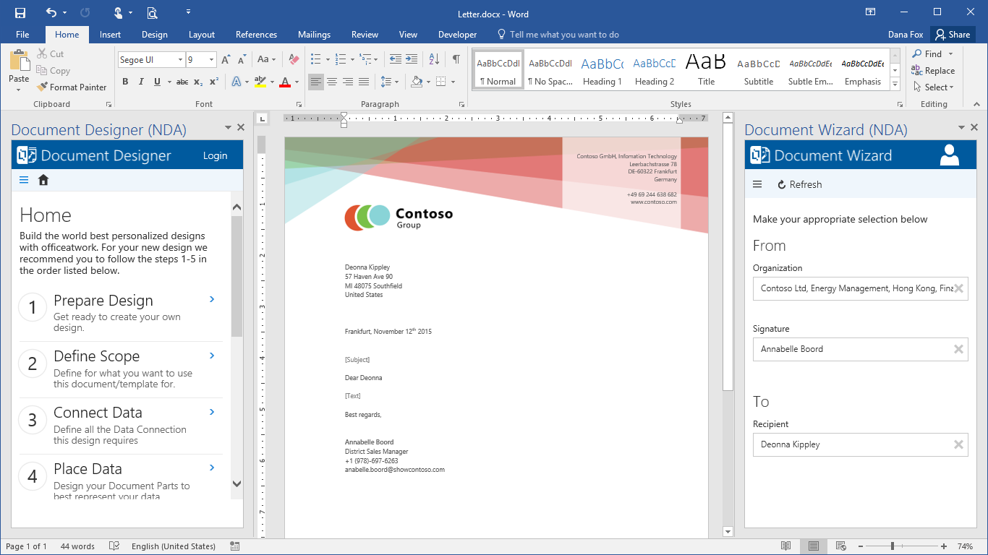
Example (video): “officeatwork”
Courtesy of Martin Seifert, CEO, “officeatwork AG”

Slide 15
Performance
Add-in must be fast and responsive with all user interactions (under a second)
Follow standard web practices to optimize your webpage
Use only minified versions of libraries
Only load resources you need
Use browser caching for subsequent load
Give the perception of fast UX
Optimize boot path (aim for <500 msec)
Show loading or other progress indicators where needed
Use a fast WW CDN for hosting resources, images, JS/HTML
Load as much as you can from one place, eliminate DNS and connection costs
Monitor your service health, use telemetry to know user success
Interaction class | Target | Upper bound | Human perception
Instant | <=50 ms | 100 ms | No noticeable delay
Fast | 50–100 ms | 200 ms | Minimally noticeable delay. No feedback necessary
Typical | 100–300 ms | 500 ms | Quick, but too slow to be described as fast. No feedback necessary
Responsive | 300–500 ms | 1 second | Not fast, but still feels responsive. No feedback necessary
Continuous | >500 ms | 5 seconds | Medium wait, no longer feels responsive. Might need feedback
Captive | >500 ms | 10 seconds | Long, but not long enough to do something else. Might need feedback
Extended | >500 ms | >10 seconds | Long enough to do something else while waiting. Might need feedback
Long running | >5 ms | >1 minute | Users will certainly do something else

Slide 16
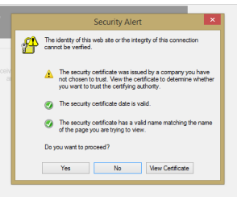
Things to watch out for…
Avoid any Active X, Flash, or any browser specific add-ons. Use HTML5 controls/APIs that work in all major browsers
Avoid pop-ups unless required for sign-in. Guide the user to enable your pop up in case of blockers
If you don’t support IE9 or older browsers, that’s fine—but show a graceful error message, inform the user and give a call to action to download the latest browser
Don’t ask users to install certificates or install any other tools. Add-ins which do will be rejected from the store
Avoid client install of any kind

Slide 17
Other do’s and don’ts of user experience
Tailored to fit with Office. User navigation and task completions must be one click away. Don’t shove your website UX into the add-in
We love your brand to show, but pick icons and neutral backgrounds that look great in Office
Ensure UX is responsive, works when browser/client resized
Allow sufficient padding, let your design breathe
Do embed help into the task
Don’t use iOS or Windows Phone Chrome and controls. This can confuse users especially if they don’t work like them
Avoid scrolling unless needed. Optimize for 1366 resolution
Don’t use unlicensed images. Developers are accountable
No funny colors or strangely sized buttons or menus. Add-ins with weird or awkward UX will be rejected

Slide 18
Run user tests/usability studies to get real user feedback early
Test across all platforms and browsers you will support
Measure performance and reliability under load
Test accessibility, localization, geopolitical concerns
Fix issues, then test again…
Testing, testing

Slide 19
Thank you

